Slide 1
IBM University Engagement Project Submission
“Exploring the Power of Agentic AI with IBM Granite and IBM Bob”

Slide 2

Project Tile – AI- Powered Startup Blueprint Generator Agent
Domain of Project – Startup & Entrepreneurship
Student Name | Recent Passport Photo | Email ID | Mobile number [WhatsApp]
JANVI AGARWAL |  | janviagarwal335@gmail.com | 7317847739
Recommended font style and size: Font Style: Arial Font Size (Heading): 28
Font Size (Content): 20

Slide 3
Problem Statement -
Problem Statement : Startup Blueprint Generator Agent
The Challenge:
Turning a raw startup idea into a practical business plan requires extensive research, including:
Market and competitor analysis
Business model development
Revenue planning
Funding and government schemes
Legal and compliance requirements
Go-to-market planning
Startup budgeting
Action planning
For beginners, this process is time-consuming, complex, and difficult to organize.
The Objective
Build an AI-powered Startup Blueprint Generator Agent that transforms a simple startup idea into a structured, research-backed, and actionable business blueprint. The solution should:
Startup Idea Analysis – Analyze the user's idea, industry, target customers, location, budget, and startup stage.
RAG-Based Information Retrieval – Retrieve relevant information on business models, startup funding, government schemes, incubators, and legal requirements from the knowledge base.
Business Planning – Generate a Business Model Canvas, value proposition, revenue model, and market strategy.
Market & Competitor Analysis – Provide market insights and identify relevant competitor categories.
Funding & Government Support – Identify potential funding opportunities, government schemes, incubators, accelerators, and investor categories.
Budget & Action Planning – Provide estimated startup costs and a practical 30/60/90-day action plan.
Startup Readiness Assessment – Generate a Startup Readiness Score to help entrepreneurs evaluate their current level of preparedness.

Slide 4
Proposed Solution-
Proposed Solution: AI-Powered Startup Blueprint Generator
The proposed solution is an AI-powered Startup Blueprint Generator Agent built using IBM Bob, IBM Granite, IBM watsonx.ai, and Retrieval-Augmented Generation (RAG) to transform raw startup ideas into comprehensive and actionable business blueprints.
At its core, StartupGenie uses a RAG pipeline to retrieve relevant startup knowledge before generating the response. The system retrieves information from a structured knowledge base covering business models, startup funding, government schemes, incubators, and legal & compliance requirements.
How the Solution Works:
User Input → RAG Retrieval → Relevant Context → IBM Granite → Startup Blueprint
The user provides:
Startup idea
Industry / sector
Target customer
Location / country
Available budget
Startup stage
The RAG system converts the knowledge-base content into embeddings and retrieves the most relevant information based on the user's startup idea.
The retrieved context is then passed to IBM Granite, which analyzes the user's requirements and generates a structured startup blueprint.
The Generated Blueprint Includes:
Startup Idea Analysis – Understands and refines the proposed startup concept.
Business Model Canvas – Defines customers, value proposition, channels, revenue streams, key activities, and other business components.
Market & Competitor Analysis – Provides relevant market insights and competitor analysis.
Revenue & Budget Planning – Suggests revenue models and provides clearly labelled estimated startup costs.
Funding & Government Schemes – Identifies relevant funding opportunities and government support based on the retrieved knowledge.
Legal & Compliance – Provides a basic checklist of relevant legal and compliance considerations.
Go-to-Market Strategy – Suggests practical customer acquisition and launch strategies.
30/60/90-Day Action Plan – Converts the business idea into actionable short-term milestones.
Startup Readiness Score – Provides an overall assessment of startup preparedness.

Slide 5
Technology Used-
IBM Bob Platform – For designing, developing, and orchestrating the StartupGenie application and its workflow.
IBM Granite Model – For natural language understanding, reasoning, and generating personalized startup blueprints from user requirements and retrieved context.
IBM Cloud – Provides the cloud infrastructure and services required to build, deploy, and scale the Startup Blueprint Generator in a reliable and secure environment.
RAG (Retrieval-Augmented Generation) – Retrieves relevant startup information from the knowledge base first and then provides it to the Granite model, making generated recommendations more context-aware and grounded.
IBM watsonx.ai – For accessing and integrating the IBM Granite foundation model and supporting the AI generation workflow.
Vector Embeddings & NumPy Vector Store – Used to convert knowledge-base content into embeddings and perform similarity-based retrieval for the RAG pipeline.
Python & FastAPI – Python is used for backend development, while FastAPI provides the API layer connecting the frontend with the RAG and Granite components.
HTML, CSS & JavaScript – Used to create the interactive StartupGenie web interface.

Slide 6
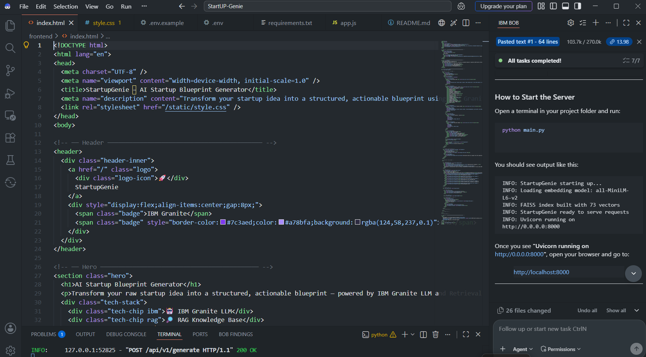
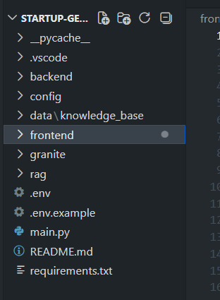
Required Files created using IBM bob -
backend/main.py
backend/routers/blueprint.py.
backend/rag/
backend/llm/granite.py
frontend/index.html
frontend/js/app.js
frontend/css/style.css
backend/knowledge_base/
requirements.txt
.env / .env.example

Slide 7
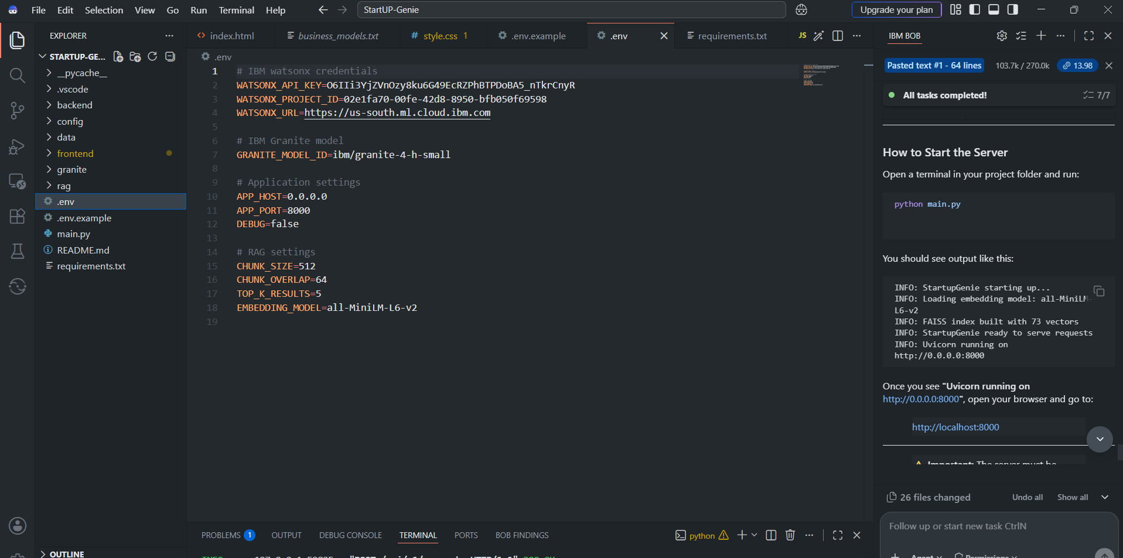
IBM Bob Screenshots:

Slide 8
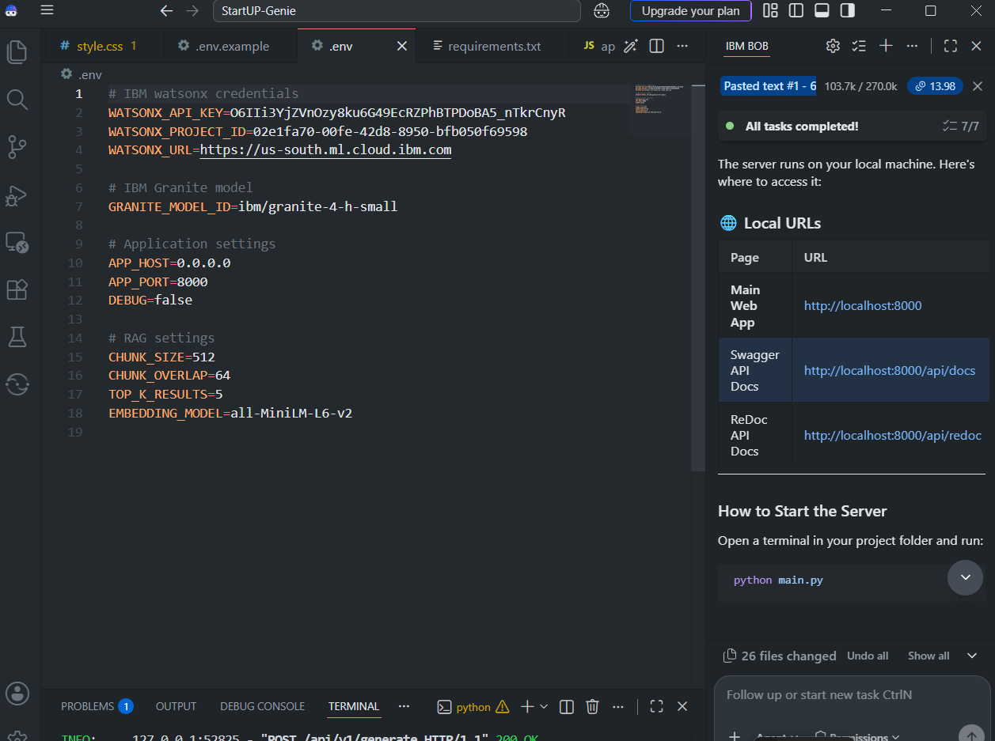

Slide 9
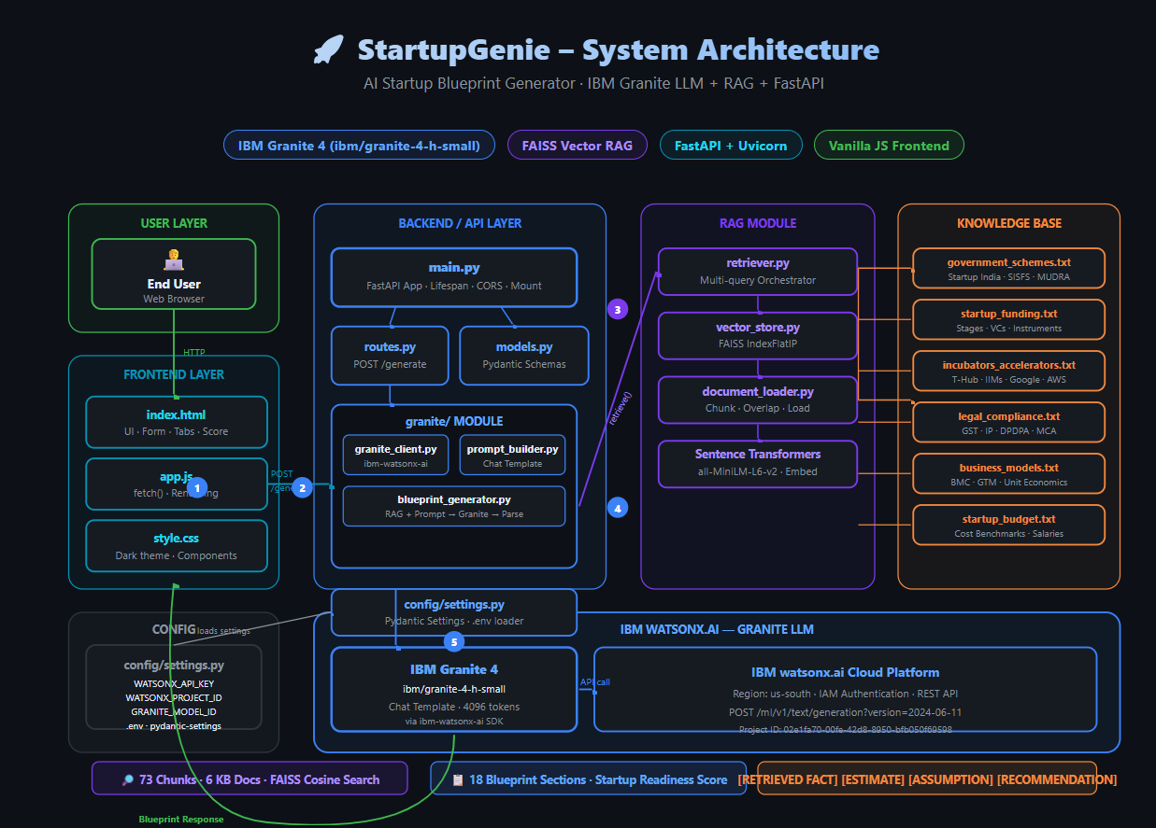
Architecture blueprint for IBM bob:

Slide 10

Role of Agentic AI in the solution
Role of Agentic AI in Startup Blueprint Generator
Agentic AI enables Startup Blueprint Generator to function as an intelligent, goal-oriented startup planning assistant rather than a simple question-answering chatbot.
The system takes the user's startup requirements and coordinates multiple steps including information retrieval, contextual analysis, business planning, and blueprint generation.
Goal-Oriented Planning
The agent understands the user's startup objective and generates a complete roadmap covering business model, market research, funding, budgeting, legal requirements, and execution planning.
RAG-Based Decision Support
The system retrieves relevant startup information from its knowledge base before generating recommendations, allowing IBM Granite to produce context-aware and grounded responses.
Context Awareness
The agent considers the user's:
Startup idea
Industry
Target customer
Location
Available budget
Startup stage
to generate a more relevant blueprint.
Autonomous Task Coordination
StartupGenie coordinates multiple tasks within one workflow:
Retrieve → Analyze → Generate → Structure → Recommend
This reduces the need for the user to manually research each aspect of starting a business.
Action-Oriented Output.
Instead of providing only conversational answers, the agent generates an actionable 18-section startup blueprint, including a Business Model Canvas, budget estimate, funding opportunities, GTM strategy, and 30/60/90-day action plan.

Slide 11
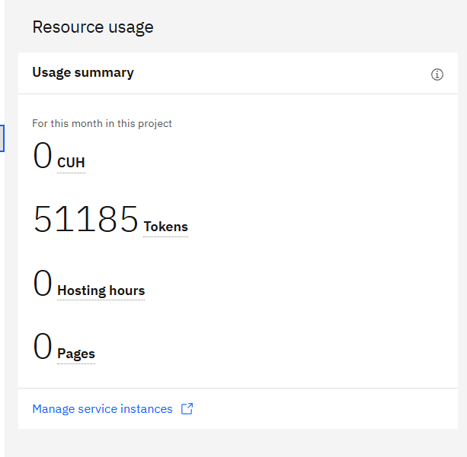

Token Usage
15.256 token are used
Before Prompt
After the Prompt
·
·
·

Slide 12
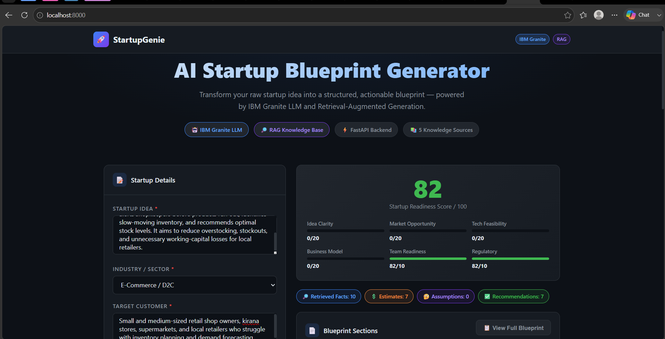
Project Output Screenshot
·
·
·

Slide 13
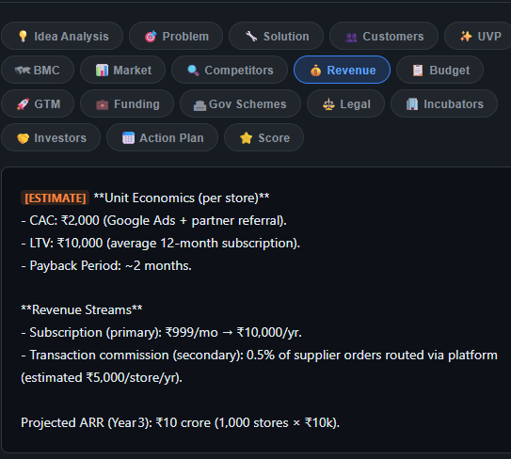
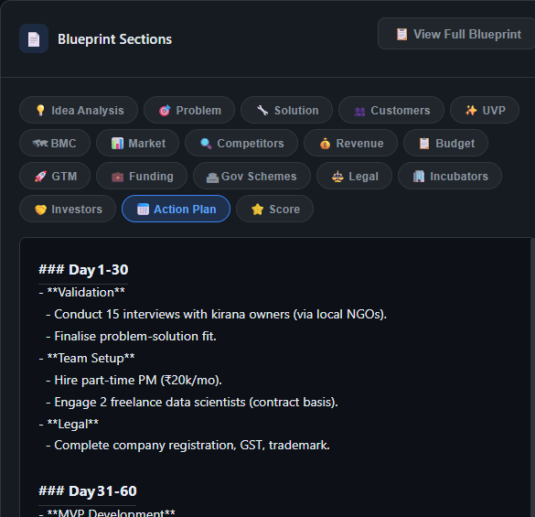
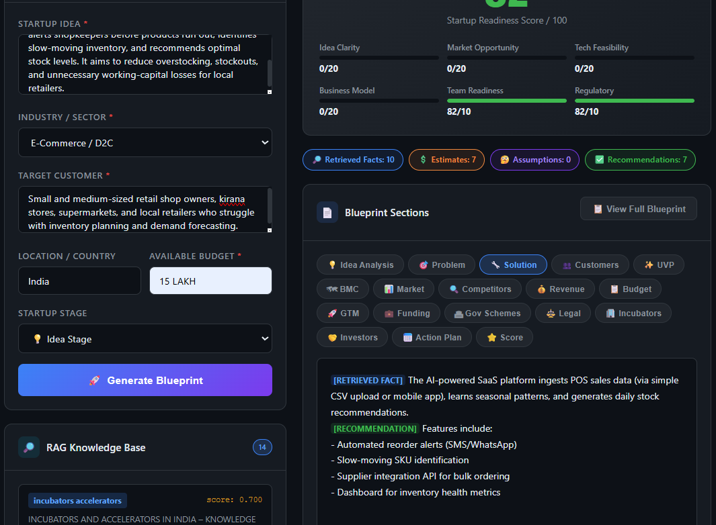
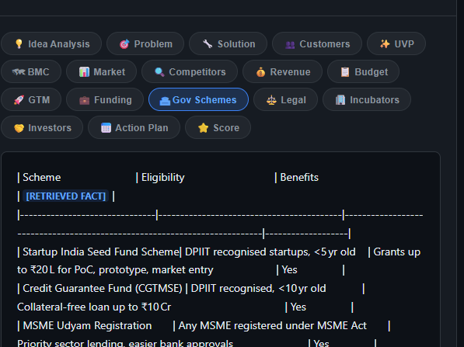
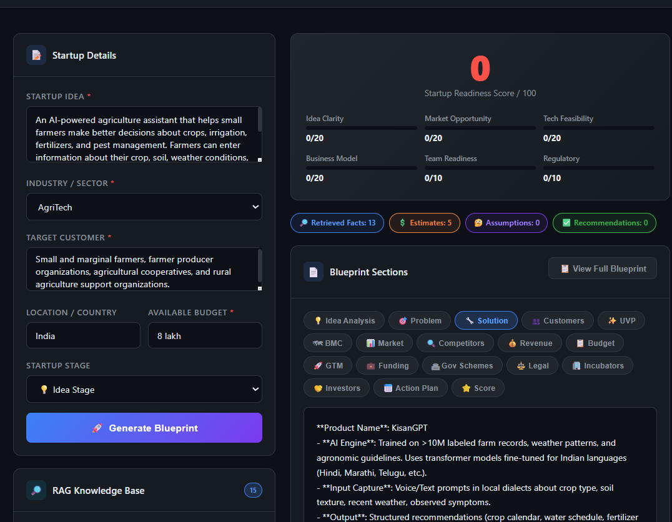
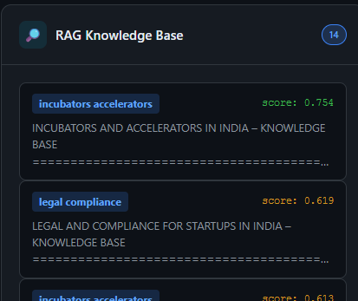
Project Output Screenshot
·
·

Slide 14
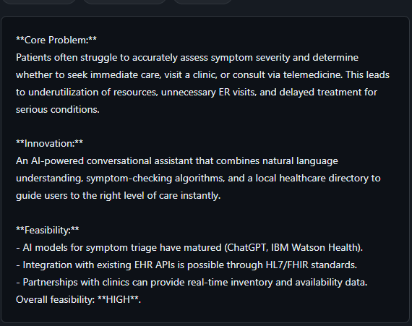
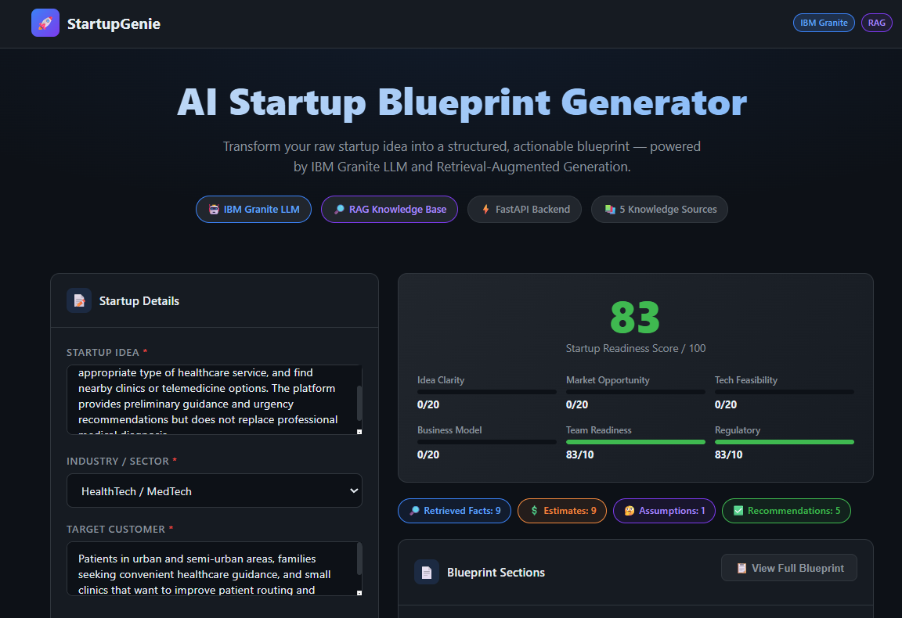
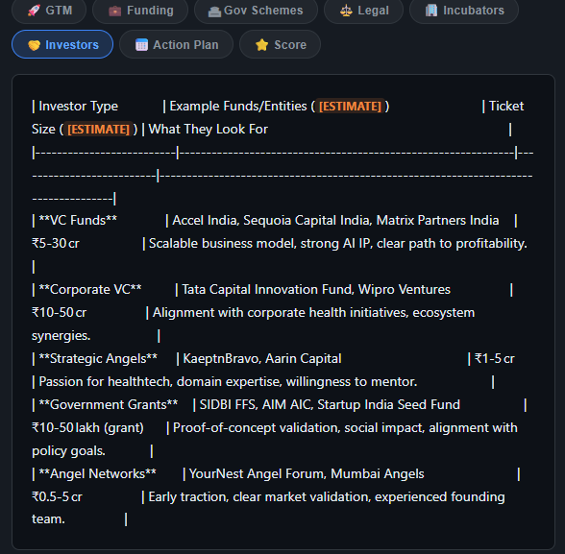
Project Output Screenshot
·
·
·

Slide 15
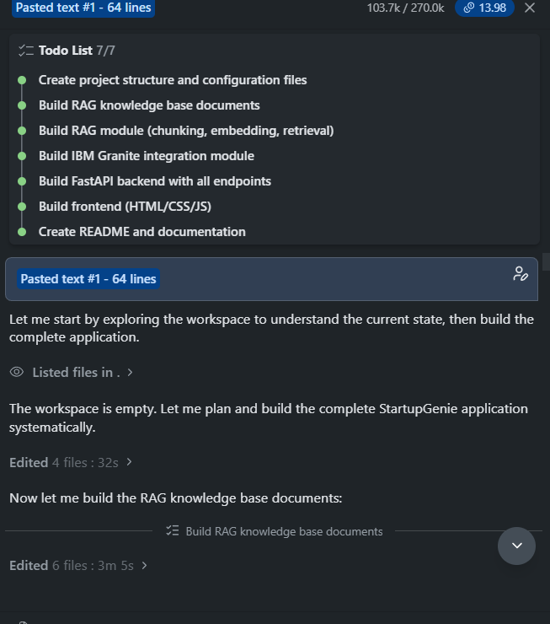
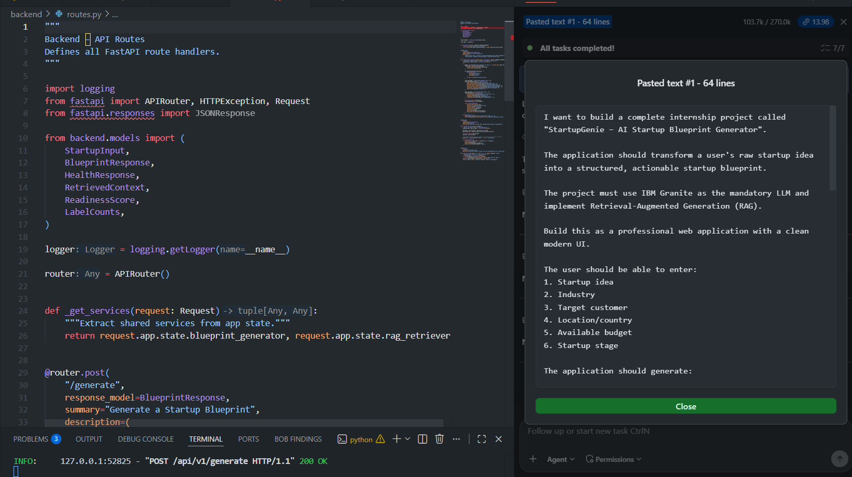
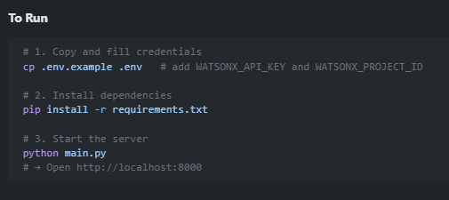
Project Output Screenshot (bob prompt)

Slide 16
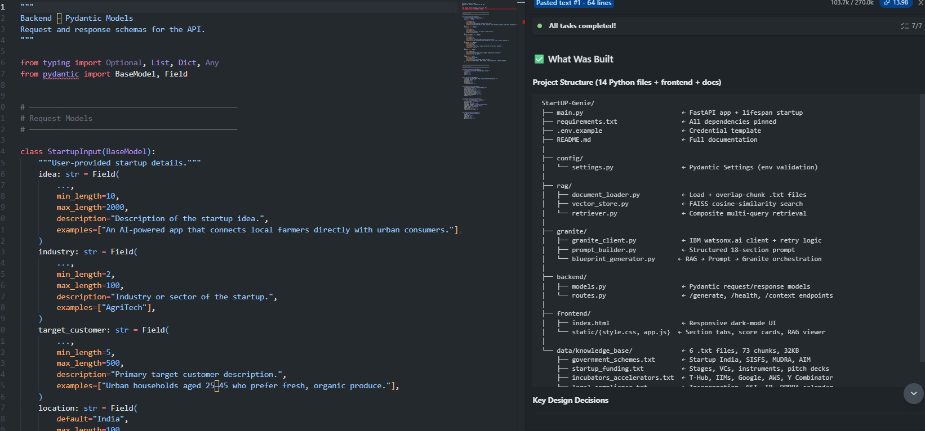
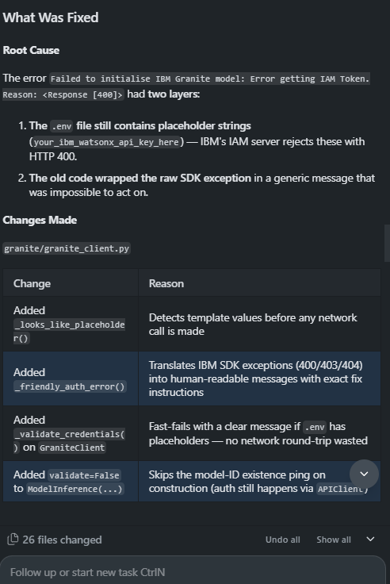
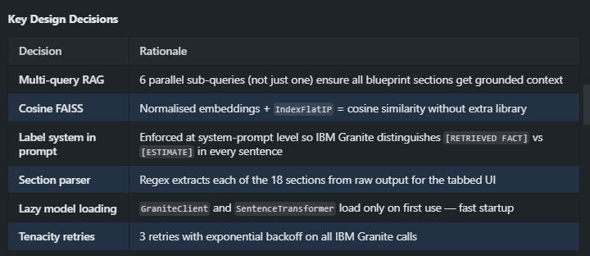
Project Output Screenshot

Slide 17
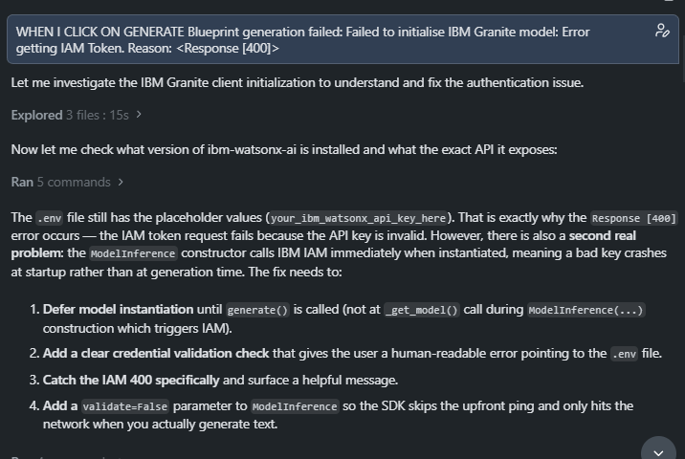
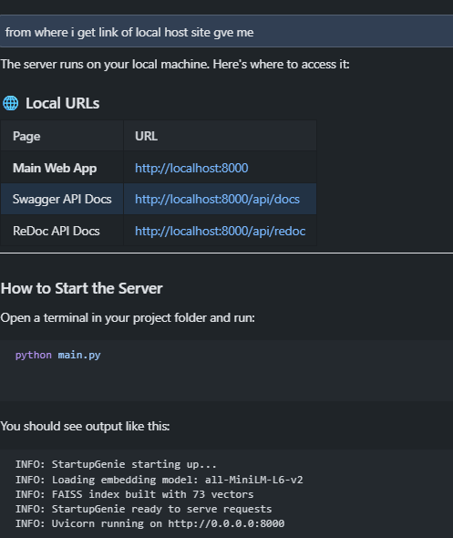
Project Output Screenshot (bob prompt/chat)

Slide 18
Novelty and Uniqueness
Startup Blueprint Generator stands out by combining Agentic AI, RAG, IBM Granite, and structured startup planning into a single intelligent system.
RAG-Grounded Startup Planning- Retrieves relevant information from a dedicated startup knowledge base before generating the blueprint, improving contextual relevance.
18-Section Comprehensive Blueprint- Instead of answering one startup question at a time, the system generates a complete blueprint covering business, market, finance, funding, legal, and execution aspects.
Context-Aware Personalization- The blueprint is tailored according to the user's industry, target customer, location, budget, and startup stage.
Transparent AI Recommendations- The system clearly distinguishes between:
[RETRIEVED FACT] [ESTIMATE] [RECOMMENDATION] [ASSUMPTION]
This helps users understand the nature of generated information.
6. Integrated Startup Research- Combines business models, funding, government schemes, incubators, and legal/compliance information into one workflow.
7. Action-Oriented Planning- Converts the startup idea into a practical 30/60/90-day action plan rather than providing only general suggestions.
8. Modular Knowledge Base- New .txt knowledge documents can be added to the knowledge base and indexed by the RAG pipeline.
9. IBM Granite Powered- Uses IBM Granite through watsonx.ai for reasoning and generation.

Slide 19
Git Hub Link
Github URL – https://github.com/Janvi24-ux/StartupGenie.git
·
·
·

Slide 20
Future Scope
1. Real-Time Startup Data Integration-
The system can be connected with live APIs and trusted web sources to retrieve updated information about funding opportunities, government schemes, market trends, competitors, and startup programs.
2. Multi-Agent Startup Ecosystem-
Future versions can introduce specialized agents such as:
Market Research Agent
Competitor Analysis Agent
Funding Agent
Legal & Compliance Agent
Marketing Strategy Agent
Financial Planning Agent
These agents can collaborate to produce more specialized startup insights.
3. Investor & Funding Platform Integration
Integration with startup funding platforms and investor databases could help users discover relevant investors, accelerators, grants, and funding programs based on their startup profile.
4. Persistent User Profiles & Startup History
A database can be added to save previous blueprints, track progress, compare different startup ideas, and monitor completion of the 30/60/90-day action plan.
5. Multilingual & Voice Interaction
Voice input and multilingual support can make Startup Blueprint Generator accessible to entrepreneurs who prefer interacting in Hindi and other regional languages.
·
·
·

Slide 21
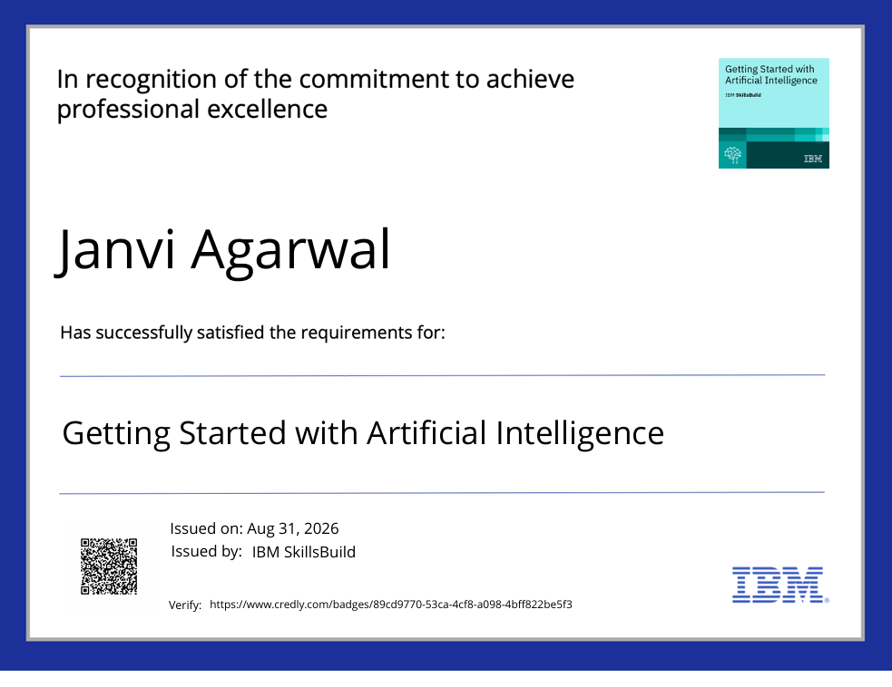
Certificates Earned:
Please add your credly certificate(Getting Started with Artificial Intelligence)

Slide 22
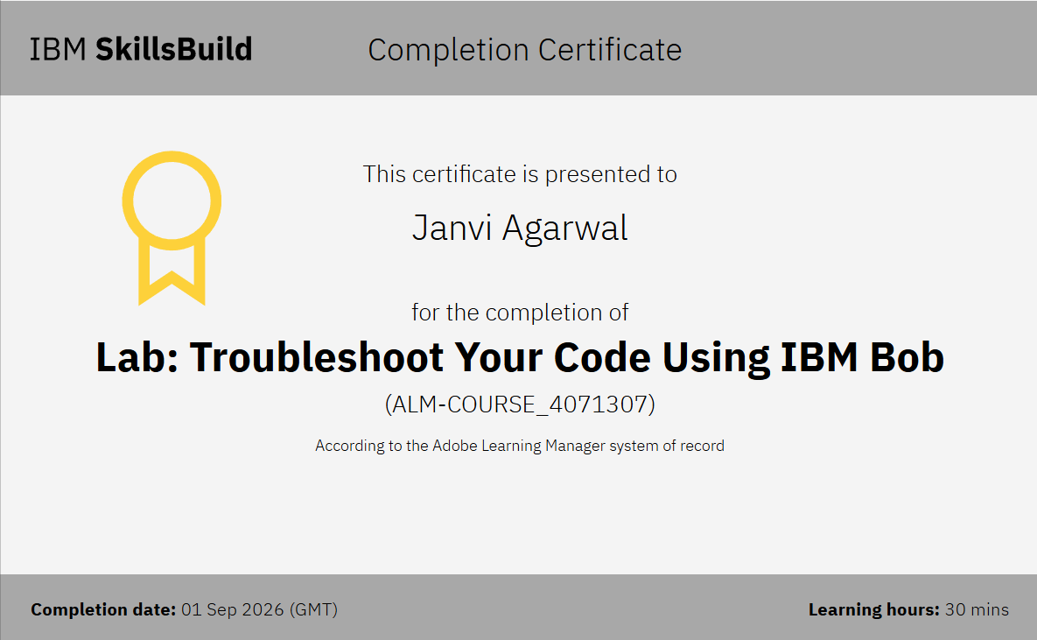
Certificates Earned:​
Add your IBM BOB Certificate

Slide 23


